Slide 1

Evaluating IoT Protocols
CU Boulder Senior Capstone Project
Jacob Hans, Chris Kardaras, Nick Wentzel

Slide 2
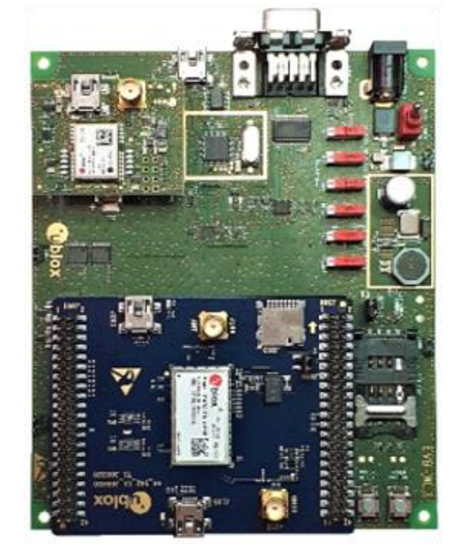

Project Overview
Senior capstone project from CU Boulder partnering with BI Inc.
Deep dive research into industry standard IoT protocols
Evaluating for potential use in future BI products
Looked into MQTT, CoAP, AMQP, and LwM2M
Use of SARA-R500S EVK from U-Blox for this project
There is an accompanying paper and code available for this project
Paper goes more in depth on the protocols

Slide 3
MQTT Summary

Slide 4

MQ Telemetry Transport
MQTT was originally developed in 1999 by IBM and became an OASIS standard in 2013
Lightweight publisher/subscriber model
Designed to be “data agnostic” (data is interpreted by the applications)
Runs over an ordered, lossless, bi-directional network protocol, typically TCP
Has a lesser implemented spinoff called MQTT-SN which has support for running over UDP
MQTT-SN is very new when compared to MQTT; less support
Well documented and commonly used in IoT networks

Slide 5
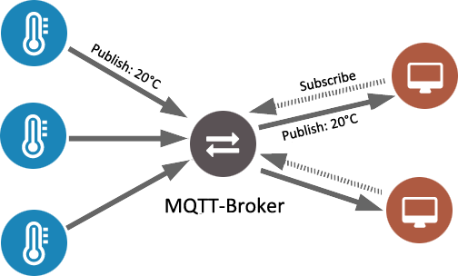
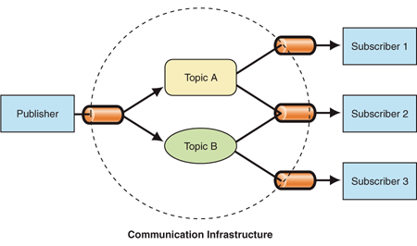
Pub/Sub model

Slide 6
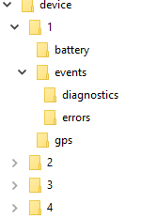
MQTT Topics
Structured in a hierarchical structure similar to folders
Sub-topics are ‘/’ delimited
Each topic must have a unique name/path
$SYS topic is reserved for broker related information
Wildcards:
+ is single level wildcard
Ex: subscribing to device/+/gps:
Receives messages from to device/1/gps, device/2/gps, device/3/gps, and device/4/gps
# is multi level wildcard
Ex: subscribing to device/4/#
Receives messages from device/4/gps, device/4/battery, device/4/events/diagnostics, and device/4/events/errors
Information is not stored on the server, topics are used to facilitate message flow to subscribers

Slide 7
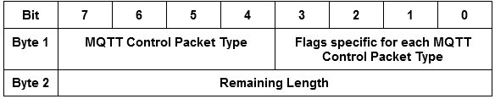
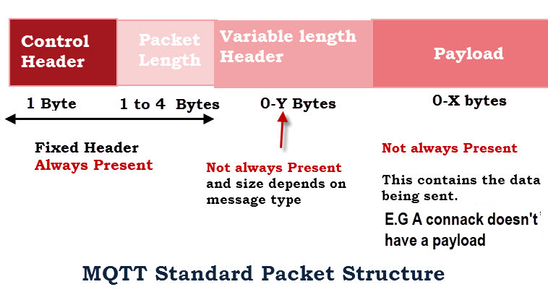
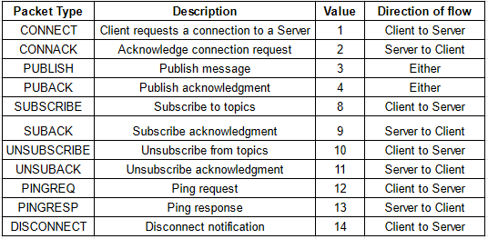
MQTT Packet Structure

Slide 8
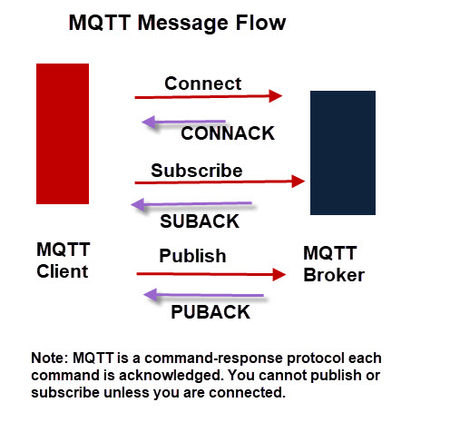
Message Types
All messages are acknowledged
CONNECT message establishes connection
SUBSCRIBE establishes a subscription
PUBLISH publishes to a topic
UNSUBSCRIBE
PING (used to keep connections open)
DISCONNECT
QoS Levels:
0 - at most once “fire and forget”
1 - at least once
2 - exactly once
Specified on both subscribing and publishing

Slide 9
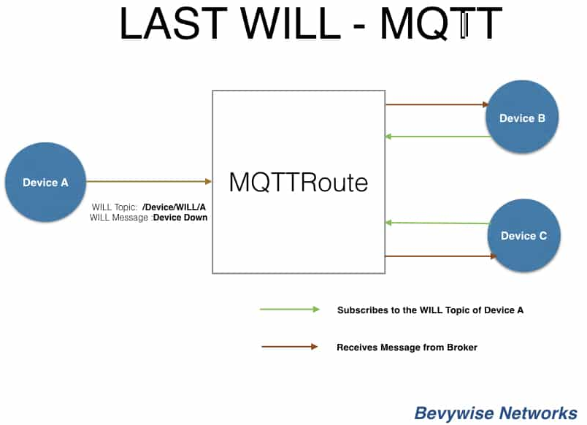
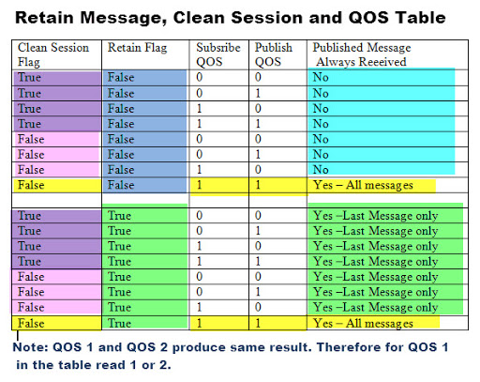
MQTT Features

Slide 10
Advantages
Disadvantages
Lightweight, small packet sizes
Reliable transfer of data due to running over TCP and QoS levels
Heavily adopted in the market, means more technical support
Easy to implement authentication and ACLs on many of the available consumer servers
Firmware support already available on the SARA R5 module
Stream-based nature makes it more difficult for back-end clients
More byte overhead due to TCP protocol and in needing to connect/disconnect
More engineering overhead in designing topic structure for applications
Broker cannot route based on message content

Slide 11


Libraries used in this project
Paho
Dominant Eclipse library with support in Java, Python, C, C++, embedded C, Lua, Go
Simple, easy to use methods for connecting and publishing/subscribing
Mosquitto
Simple open source broker that can be implemented locally
Can be configured to run with SSL and authentication mechanisms
Also offers command line publisher and subscriber utilities
Can be run in the cloud as well as on-site implementations
Other Libraries
Brokers: HiveMQ, RabbitMQ, EMQ
Clients: hivemq-mqtt-client, mqtt.js (largest client library is Paho)

Slide 12



Industry Users & Applications
Messenger uses MQTT for sending messages between users
BMW uses MQTT for their car sharing app
Deutsche Bahn Railway system sending train location updates

Slide 13
AMQP Summary

Slide 14

Advanced Message Queueing Protocol
Originated in 2003 by JPMorgan Chase
In 2011, AMQP was adopted as an OASIS standard
Open Standard message-oriented middleware
Similar to MQTT
Typically runs over TCP
Similar pub/sub model
Also “data agnostic” so no restrictions on type of data sent

Slide 15
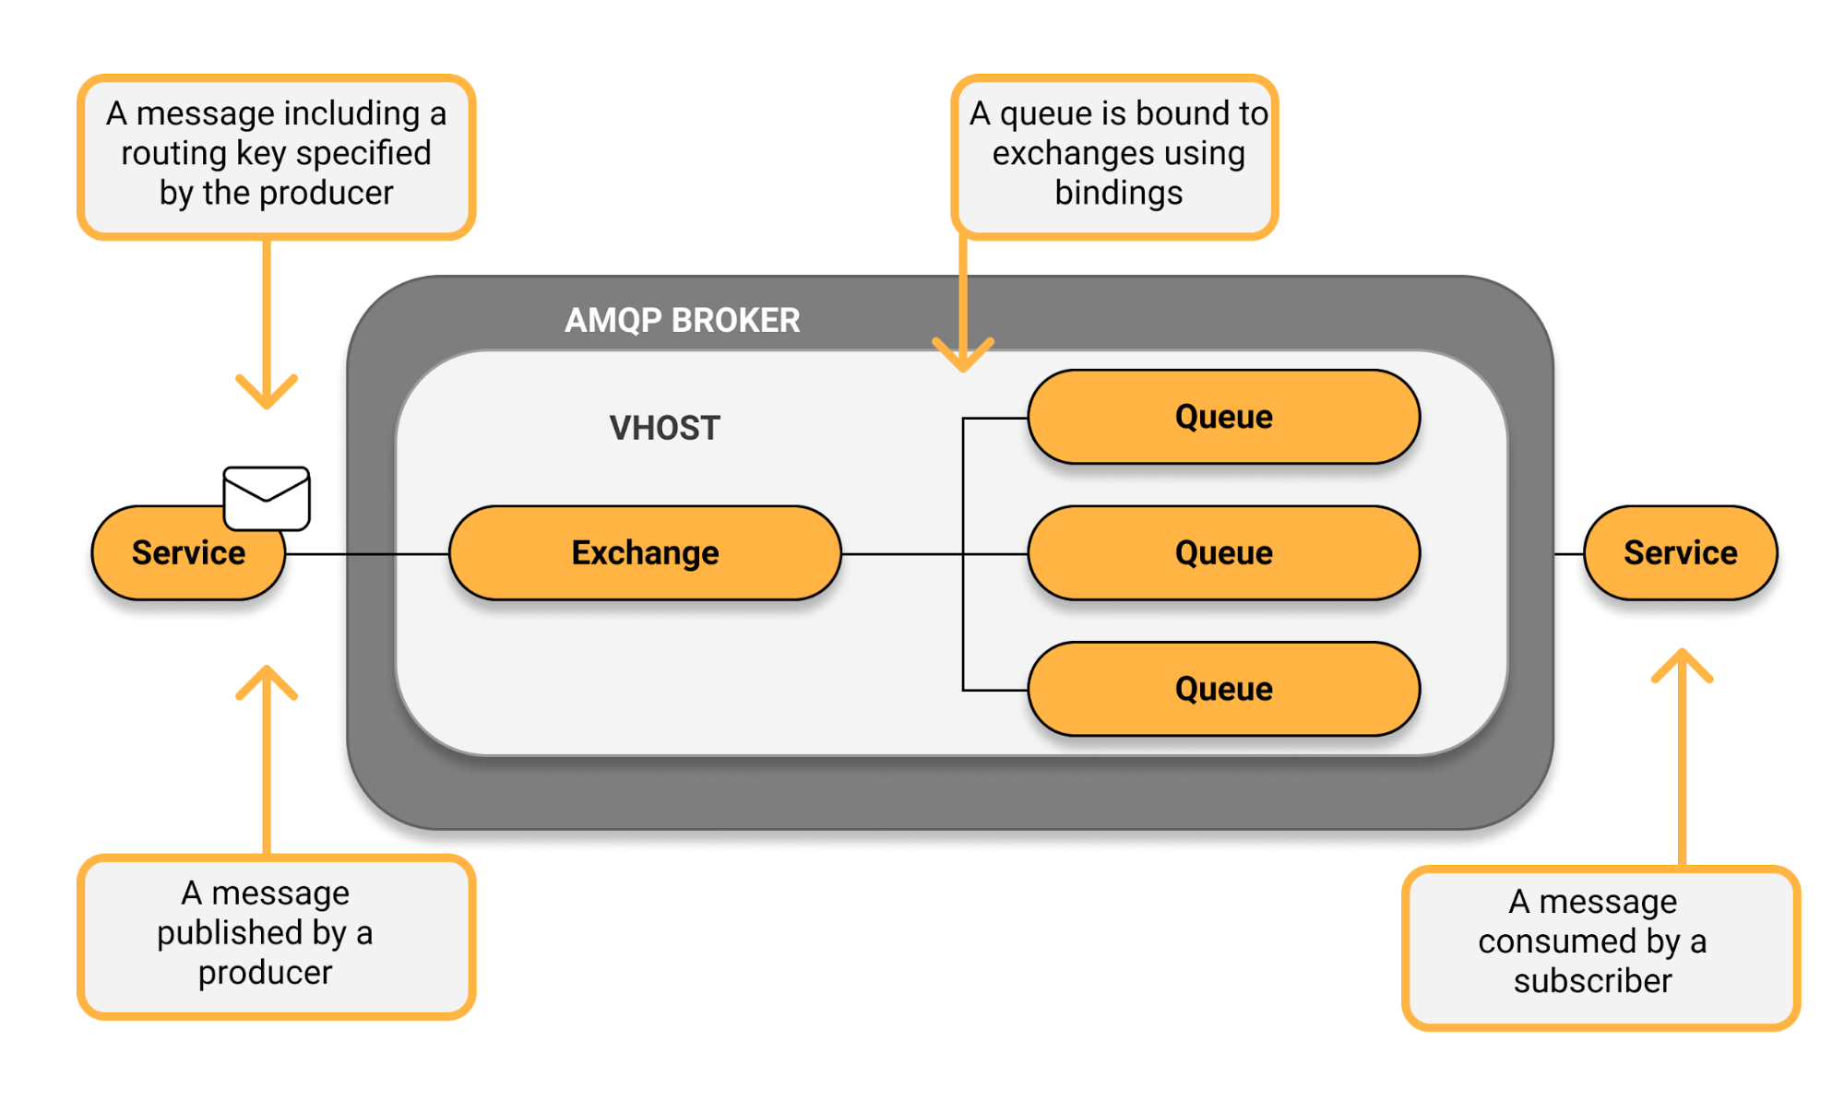
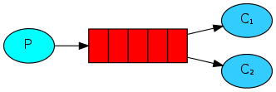
Producer/Consumer model

Slide 16
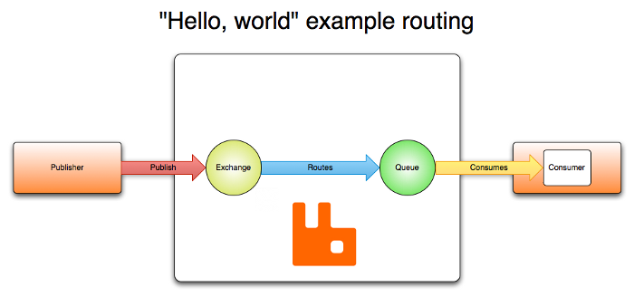
Queues
Stores messages that are consumed by consumer
Properties:
Name
Durable: Queue will survive broker restart
Exclusive: Used by only 1 connection, deleted upon loss of connection
Auto-Delete: When has no more subscribers deleted
Arguments: Used by plugins and broker specific features

Slide 17
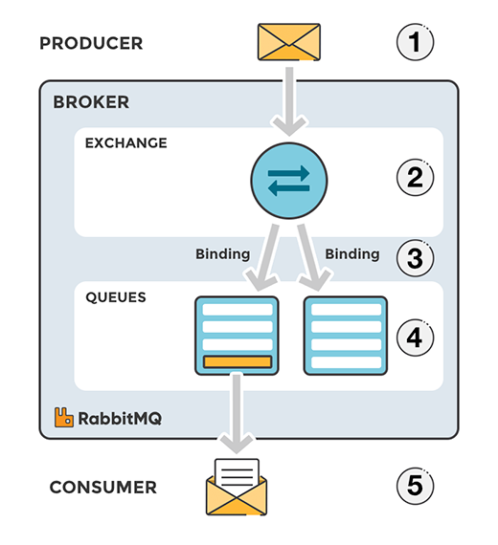
Bindings & Routing Keys
Binding: A ‘link’ that is setup to connect a queue to an exchange
Routing Key: A message attribute the exchange looks at to decide which (if any) of it’s bound queues to route a message to
Messages that cannot be routed to any queues are either dropped or returned to publisher

Slide 18
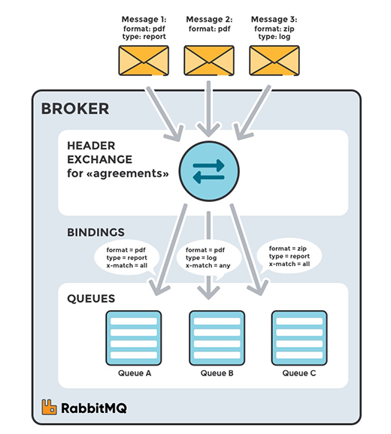
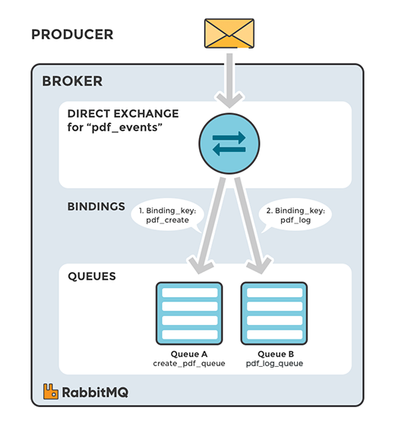
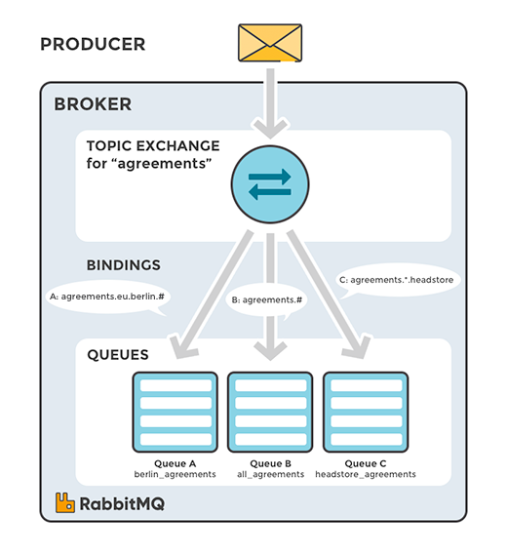
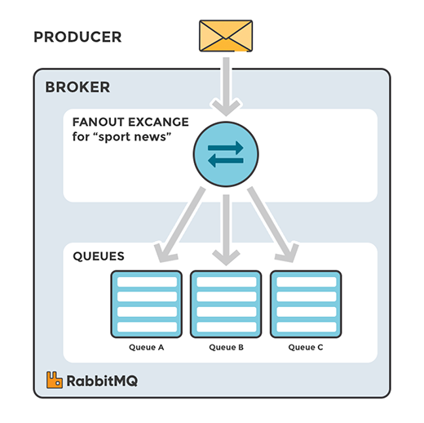
AMQP Exchanges

Slide 19
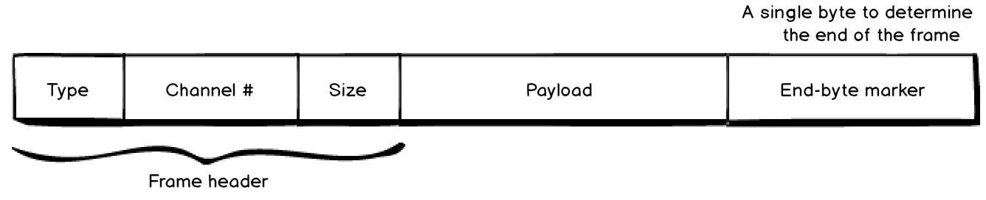
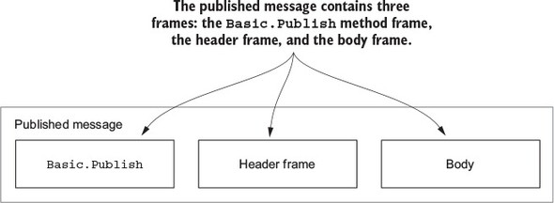
Anatomy of a Frame
A Frame is how data is sent over AMQP, there a 5 types of Frames:
Protocol Header:
Frame sent to establish a connection between broker and client (only used once)
Method Frame:
Carries rpc requests and responses (example: used in Basic.Publish)
Content Header (Header Frame):
Used to send properties of content
Body:
The actual content of the message being sent, can be split into multiple frames if message surpases limit (default frame size limit is 131 KB)
Heartbeat:
Used to confirm that a client is still alive

Slide 20
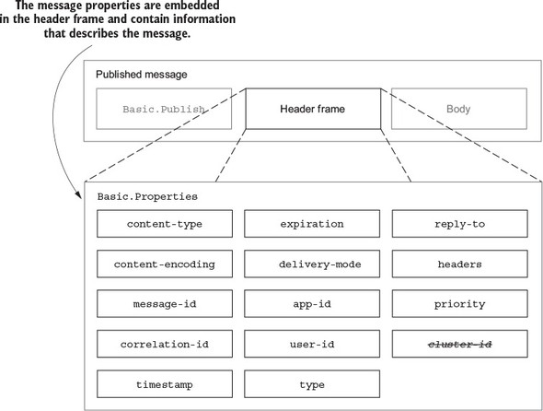
Lots of Overhead
There is a lot of overhead and options in AMQP, the header frame alone has all of these properties!

Slide 21
Data Safety in AMQP
Consumer Acknowledgement: a confirmation mechanism that allows consumers to acknowledge deliveries to the node they are connected to
Three Types:
Basic.ack: positive acknowledgements
Basic.nack: negative acknowledgements (can reject or reque multiple messages at once)
Basic.reject: negative acknowledgement (can not be used on multiple messages)
Channel Prefetch Settings (QoS): Since all messages from queues are pushed to clients asynchronously, implementing this feature can allow for some load balancing between the clients.
Publisher Confirms: protocol extension that allows for broker acknowledgment to publisher

Slide 22
Advantages
Disadvantages
Exchanges & bindings allow for distribution of messages based on content
Adds support for transactions via the different types of acknowledgements
Also has TLS support and an authentication system
Greater support for Kerberos tickets as well as username/password
No firmware support on the SARA R5 module, would need to implement a client from scratch
Large overhead in header options and establishing connections
Not designed for low-power and constrained devices

Slide 23

Libraries used in this project
Other Libraries
Pika
Simple python library to implement AMQP
RabbitMQ
Simple open source broker that can be implemented locally
Can run MQTT as well as AMQP standards
Can be configured to run with SSL and authentication mechanisms
StormMQ, MQLight by IBM, Apache Qpid

Slide 24





Industry Users & Applications
Microsoft Azure IoT Hub
Used Primarily for Bank Transactions

Slide 25
CoAP Summary

Slide 26
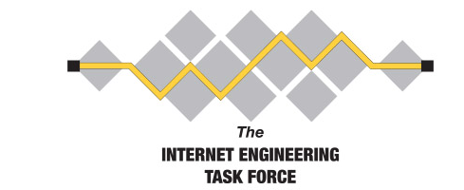
Constrained Application Protocol
Standardized by Internet Engineering Task Force (IETF) in June 2014
Proposed Standard RFC (Request for Comments) 7252 (Internet Standard)
Designed for lossy networks and primarily runs over UDP
Request/Response or Client/Server communication model
Built to be like HTTP and integrates well with it
Designed to be a low power REST system for IoT devices
Focused on recreating the REST paradigm

Slide 27
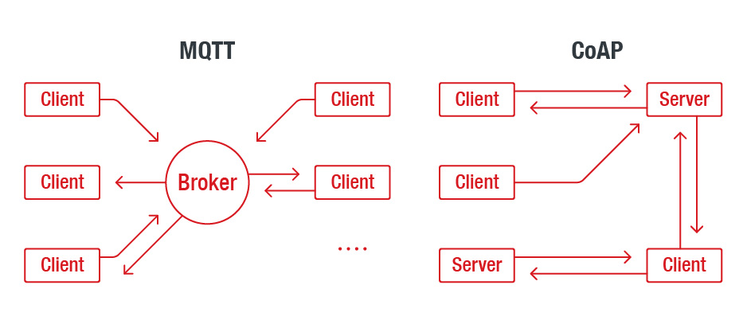
High Level Overview
Preferred for gathering telemetry data transmitted from transient, low-power nodes like tiny field sensors.
A client node can command another node by sending a CoAP packet. The CoAP server will interpret it, extract the payload, and decide what to do depending on its logic. The server does not necessarily have to acknowledge the request.
Publisher-Subscriber Paradigm
Request-Response Paradigm

Slide 28
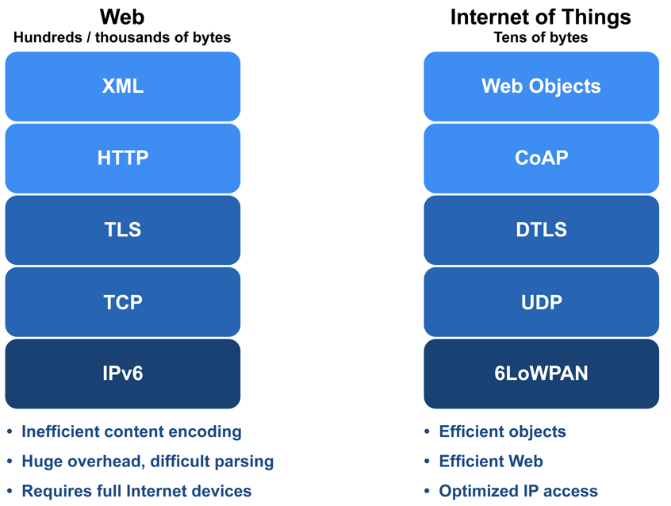
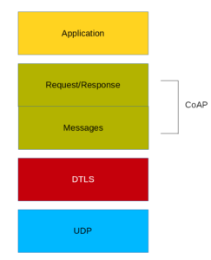
Like HTTP
Uses REST Model: Servers make resources available under a URL, and clients access these resources using methods such as GET, PUT, POST, and DELETE.
Existing Skill Transfer: Obtaining a value from a sensor is not much different from obtaining a value from a Web API.

Slide 29
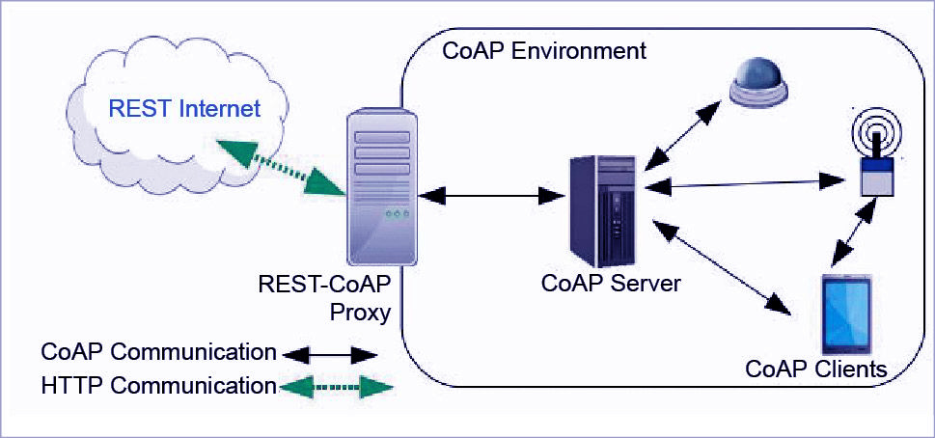
Using a Proxy

Slide 30
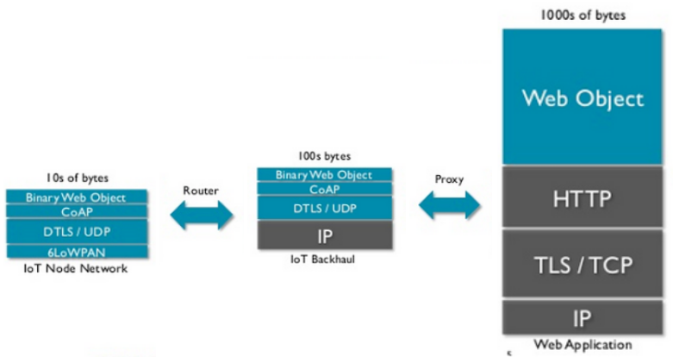
U-Blox SARA R5 only uses middle step
6LoWPAN devices send to CoAP server, which then sends data via a proxy to a RESTful Web Application

Slide 31
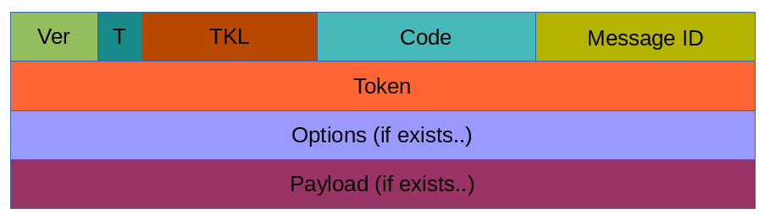
Packet Format
4 Byte header
Version 2-bits
Message Type 2-bits
Token Length 4-bits
Code 8-bits
Message ID 16-bits

Slide 32
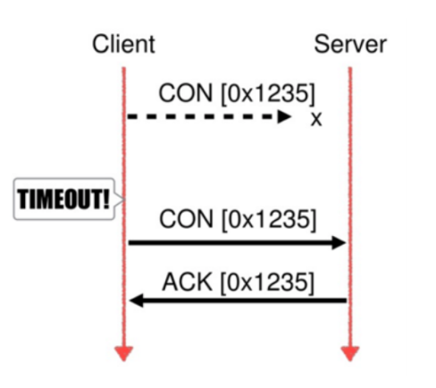
Reliability
Message Reliability is handled at the application layer
Confirmable vs Non-Confirmable messages
“CoAP senders use retransmission timeout (RTO) to infer losses that have occurred in the network.” (ietf)
Congestion control (retransmits increase exponentially based on the value of RESPONSE_TIMEOUT and MAX_RETRANSMIT)
Feature can be disabled
Reset (RST) is sent to indicate that a specific message (either CON or NON) were received , but some context is missing to properly process the data.
Usually encountered when a receiving node has rebooted and forgotten some state that would have been required to interpret a message

Slide 33
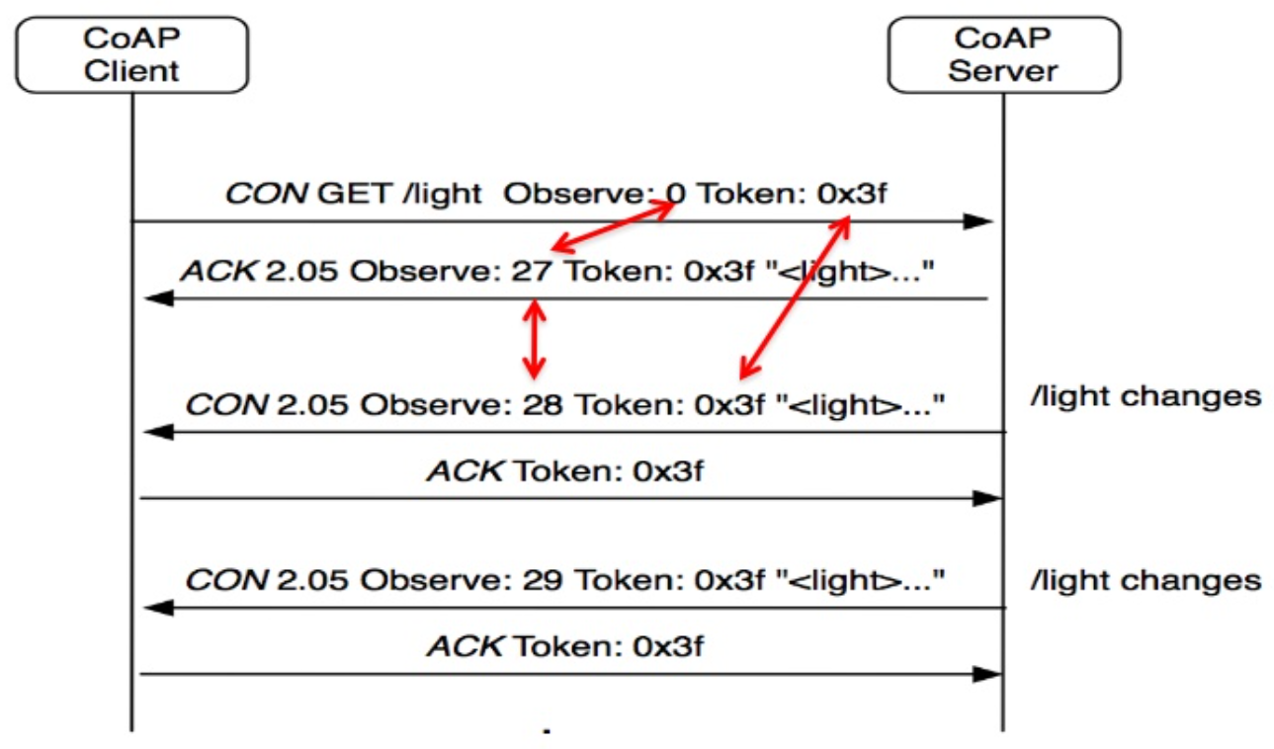
Observer Pattern (subscribe)
A ‘Pub-Sub’ Mechanism for CoAP
For use when client is interested in a resource over a period of time
Constrained device acts as a server
Observe Value 0 - sub
Observe Value 1 - unsub

Slide 34
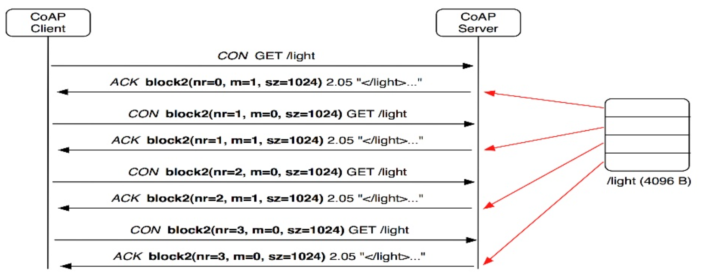
Block Transfer for larger data transmission
UDP does not support packet fragmentation
CoAP supports block transfer
CoAP provides application level support for splitting data across multiple packets

Slide 35
Advantages
Disadvantages
Smaller Packet Size: Since CoAP uses UDP, we have small packet sizes
Security: DTLS can be applied to UDP for transport security (coap:// and coaps://)
IPv6 based: Designed from the beginning to support IPv6, as such it supports multicasting
SARA R5 Support: firmware support for CoAP on the SARA R5 module
Lacks Quality of Service: UDP does not guarantee delivery of datagrams. CoAP uses confirmable messages for reliability
Standards are still Maturing: CoAP is still evolving
Firewall Rules: Operating through UDP could run into potential firewall complications
Authentication: more difficult to implement than with AMQP and MQTT due to RESTful nature (would be handled similar to HTTP)

Slide 36
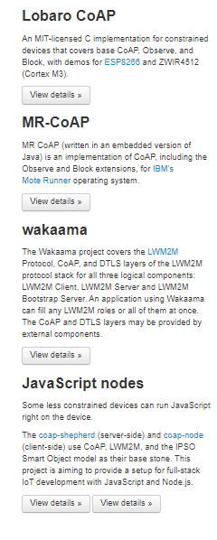
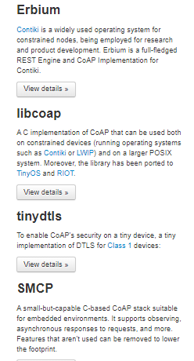
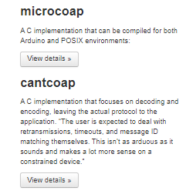
Libraries upon Libraries...
Constrained Devices:

Slide 37
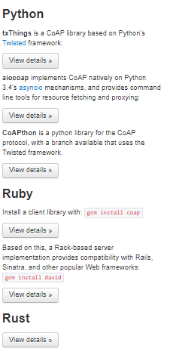
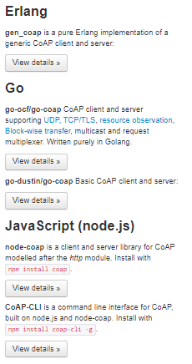
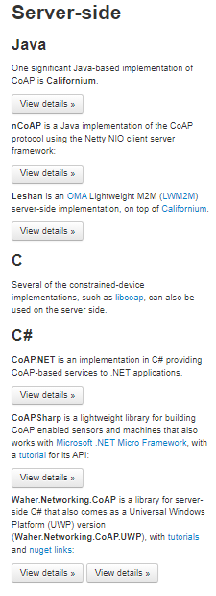
Libraries upon Libraries...
Server-Side and computer clients:

Slide 38



Industry Users & Applications
Develops Proxy Server Solutions for CoAP
IKEA Smart-Home products

Slide 39
LwM2M Summary

Slide 40
Lightweight Machine-to-Machine Protocol
Has basic M2M (Machine to Machine) functionalities: Server, Access Control, Device Connectivity, Firmware Update, Location, and Connectivity Statistics
Designed for constrained devices (memory and battery limitations)
Runs on top of CoAP and especially intended and designed for device management
Can also operate under MQTT under very new specifications
Could be used for application data, but was designed as a CoAP extension for device management
Defined by Open Mobile Alliance (OMA)
Accepted/published in 2013, 1.2 published Oct 2020
More prevalent on the cell carrier side

Slide 41
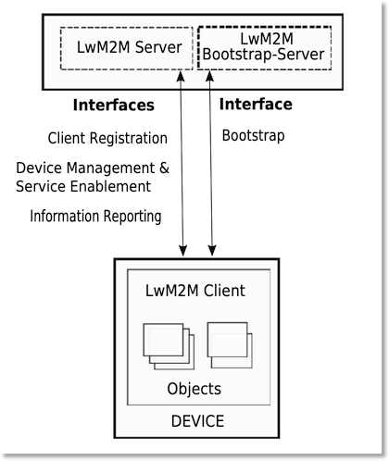
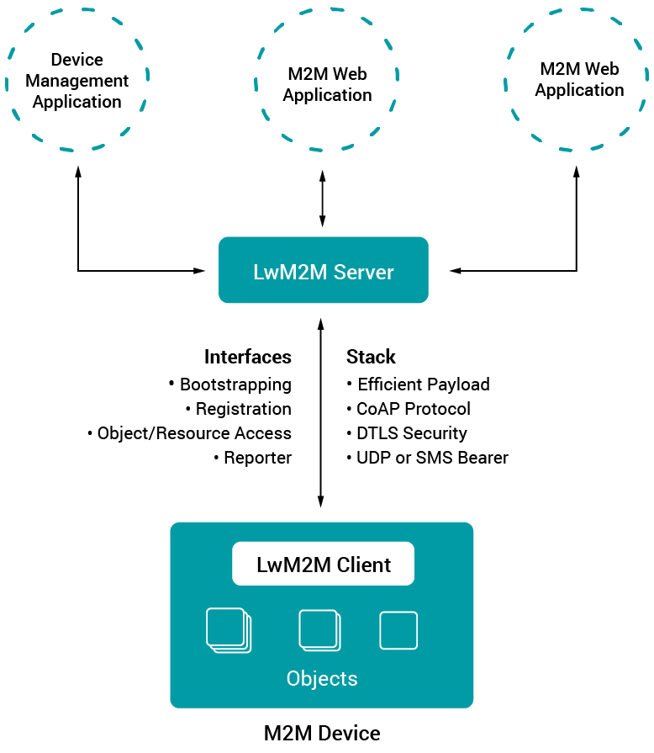
Overall Structure
LwM2M comes with a well-defined data and communication model

Slide 42
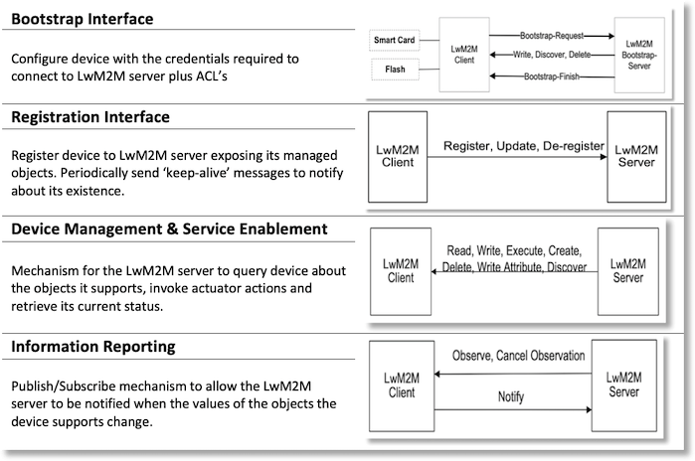
The 4 Interfaces of LwM2M

Slide 43
Security Overview
DTLS Security options
Pre-shared Key, Raw public key, certificate mode
Authentication
Requires authentication before exchange of data
Bootstrapping
Pre configured bootstrapping (flash or smart card)
Used for configuration and keying

Slide 44
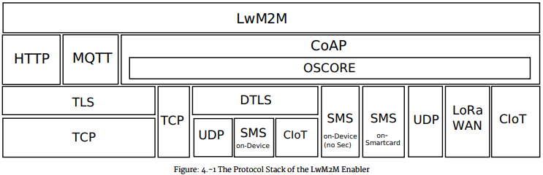
LwM2M Protocol Stack

Slide 45
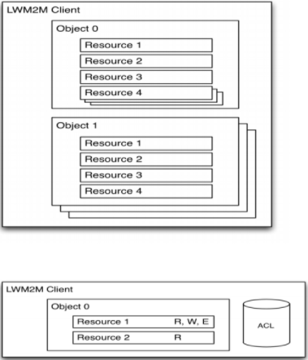
LwM2M Object Model
Objects are a collection of resources
Resources have RWX options
Objects identified by 16 bit integers
Instances referenced by an 8 bit integer
Objects/resources referenced by a uri
/{Object ID}/{Object Instance}/{Resource ID}
Can apply Access Control Lists to objects for security
Can transfer data using the following encodings:
Plain text
TLV
JSON
Concise Binary Object Representation (CBOR)

Slide 46
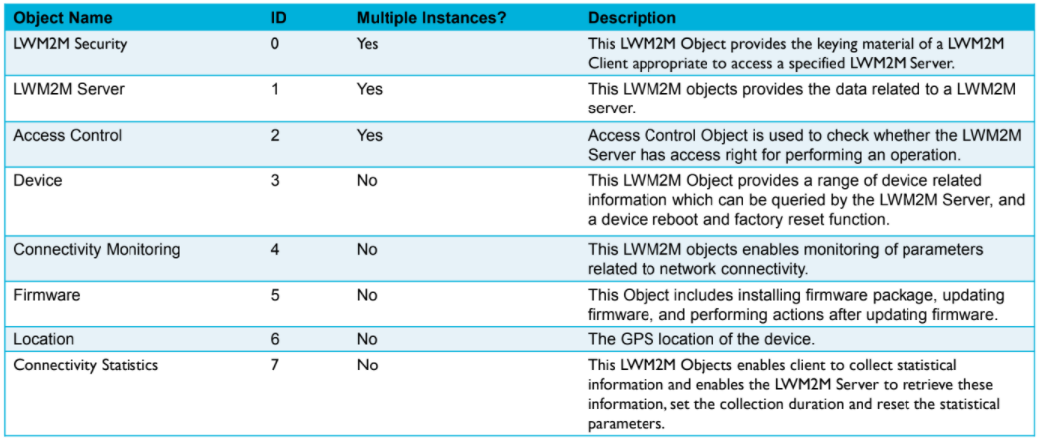
Predefined Object Types

Slide 47
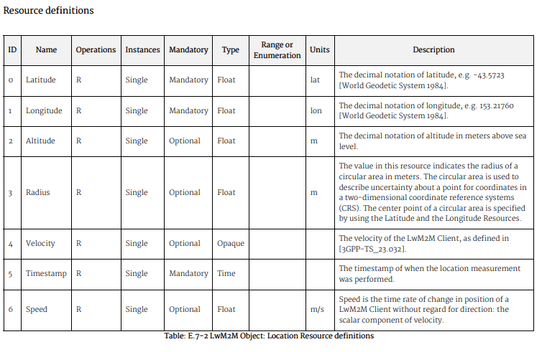
Location example
The object id for location is 6
To access latitude you would request
/6/0 [single instance]/0

Slide 48
Advantages
Disadvantages
Well defined object model provides lightweight uri encoding
Robust security and bootstrapping simplifies device provisioning
CoAP provides high performance
SARA R5 firmware support available
Ran into difficulties in SARA R5 implementation
Complex and more difficult to use
Young protocol with less adoption compared to MQTT/AMQP

Slide 49


Libraries used in this project
Other Libraries
Primarily dominated by Eclipse Leshan (Java)
Client and Server implementations
Zephyr project (C)

Slide 50




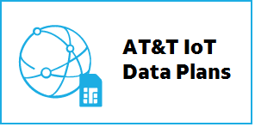
Industry Users & Applications

Slide 51
Implementing the Protocols on the SARA-R500S

Slide 52
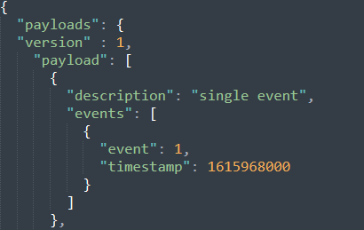
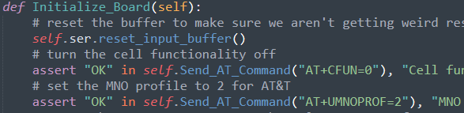
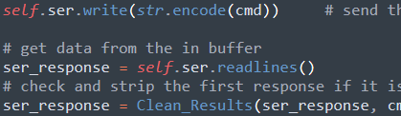
Setup
First implementation on computer clients for packet captures
Learned the protocols on computers then carried it down to the hardware
Boards provided by U-Blox for this project
Use of an AT&T sim card and plan
JSON data provided to be representative of BI Inc’s data
Different payloads
“Single-event”, “single-event w/data”, “location event”, “multiple events”, “4 hours of GPS data”
Had to send larger payloads in “chunks” on the board due to limitations
Use of PySerial library to send AT commands in an automated fashion
Built a class structure to make sending data via MQTT and CoAP easier

Slide 53
Packet Capture Analysis

Slide 54
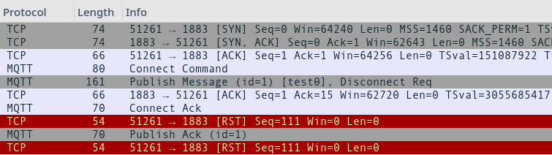
MQTT Comparison

Slide 55
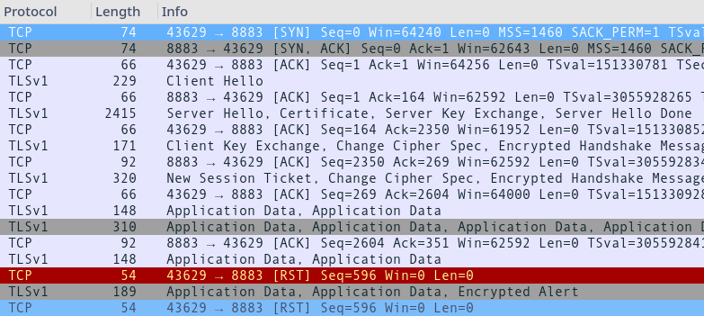
MQTT Comparison: TLS

Slide 56

AMQP

Slide 57

AMQP: TLS

Slide 58


CoAP Comparison

Slide 59

Results
CoAP performed best when payload size is small (< 16k bytes)
DTLS adds lower overhead than TLS
CoAP block transfer causes significant overhead which is used when payload size is larger than 16k bytes

Slide 60
Current Consumption Analysis

Slide 61


Analog Discovery 2 Setup
Used AD2 scope to measure voltage drop across J109 pin
Use of 1.5 Ohm shunt resistor to calculate current
Sampled at 16kHz for finely grained resolution

Slide 62

MQTT Connect/Disconnect Event

Slide 63

MQTT vs CoAP Single Event

Slide 64

MQTT vs CoAP Single Event with Data

Slide 65

MQTT vs CoAP Location Data

Slide 66

MQTT vs CoAP Multiple Events

Slide 67

MQTT vs CoAP 4 Hours of GPS Data

Slide 68

Periodic Modem Ping Event (every 1.2 seconds)

Slide 69

Results
MQTT incurs penalty of the connect and disconnect events every “fresh” event (not already connected)
As seen in the graphs, CoAP took almost 5 times longer to send the large GPS payload
MQTT took 2.18 minutes, CoAP took 9.17 minutes to send the large GPS payload

Slide 70
Recommendations
AMQP is not feasible for the needs of BI products
Not low-power oriented, difficult to implement (no board support)
MQTT and CoAP are successful in different contexts
Blended approach of MQTT and CoAP
Use CoAP to send small payloads (i.e diagnostic messages)
Use MQTT to send larger payloads (i.e files, data dumps)
As seen in the analysis, CoAP performs better for small payloads, falls short on large payloads

